Slide 1

The Cortana Intelligence Suite
Foundations – Deployment
Microsoft Machine Learning and Data Science Team
CortanaIntelligence.com
Notes:
Main page: http://cortanaanalytics.com
To begin this module, you should have:
Basic Math and Stats skills
Business and Domain Awareness
General Computing Background
NOTE: These workbooks contain many resources to lead you through the course, and provide a rich set of references that you can use to learn much more about these topics. If the links do not resolve properly, type the link address in manually in your web browser. If the links have changed or been removed, simply enter the title of the link in a web search engine to find the new location or a corollary reference.

Slide 2

Section 6 Learning Objectives
Understand how to publish an Azure ML API
Understand the access methods of Azure Storage and Intelligent processing systems
Understand the options to send a HIVE query to an HDI system
Use Power BI to Access Data
Notes:
At the end of this Module, you will:
Understand how to publish an Azure ML API
Understand the access methods of Azure Storage and Intelligent processing systems
Understand the options to send a HIVE query to an HDI system
Use Power BI to Access Data

Slide 3
The Data Science Process and Platform

Slide 4
The Team Data Science Process
Business Understanding
Define Objectives
Identify Data Sources
Data Acquisition and Understanding
Ingest Data
Explore Data
Modeling
Feature Selection
Create and Train Model
Deployment
Customer Acceptance
Operationalize
Testing and Validation
Update Data
Handoff
Re-train and re-score
Notes:
This process largely follows the CRISP-DM model: http://www.sv-europe.com/crisp-dm-methodology/
It also references the Cortana Intelligence process: https://azure.microsoft.com/en-us/documentation/articles/data-science-process-overview/
A complete process diagram is here: https://azure.microsoft.com/en-us/documentation/learning-paths/cortana-analytics-process/
Some walkthrough’s of the various services: https://azure.microsoft.com/en-us/documentation/articles/data-science-process-walkthroughs/
An integrated process and toolset allows for a more close-to-intent deployment
Iterations are required to close in on the solution – but are harder tio management and monitor
Data Science Blog: https://buckwoody.wordpress.com/

Slide 5
The Cortana Intelligence Platform
Cortana, Cognitive Services, Bot Framework
Power BI
HDInsight
Stream Analytics
Azure Machine Learning (MRS)
SQL Data Warehouse (SQL DB, Document DB)
Data Lake
Event Hubs
Data Factory
Data Catalog
Microsoft Azure
Notes:
Platform and Storage: Microsoft Azure – http://microsoftazure.com Storage: https://azure.microsoft.com/en-us/documentation/services/storage/ (Host It)
Azure Data Catalog: http://azure.microsoft.com/en-us/services/data-catalog (Doc It)
Azure Data Factory: http://azure.microsoft.com/en-us/services/data-factory/ (Move It)
Azure Event Hubs: http://azure.microsoft.com/en-us/services/event-hubs/ (Bring It)
Azure Data Lake: http://azure.microsoft.com/en-us/campaigns/data-lake/ (Store It)
Azure DocumentDB: https://azure.microsoft.com/en-us/services/documentdb/ , Azure SQL Data Warehouse: http://azure.microsoft.com/en-us/services/sql-data-warehouse/ (Relate It)
Azure Machine Learning: http://azure.microsoft.com/en-us/services/machine-learning/ (Learn It)
Azure HDInsight: http://azure.microsoft.com/en-us/services/hdinsight/ (Scale It)
Azure Stream Analytics: http://azure.microsoft.com/en-us/services/stream-analytics/ (Stream It)
Power BI: https://powerbi.microsoft.com/ (See It)
Cortana: http://blogs.windows.com/buildingapps/2014/09/23/cortana-integration-and-speech-recognition-new-code-samples/ and https://blogs.windows.com/buildingapps/2015/08/25/using-cortana-to-interact-with-your-customers-10-by-10/ and https://developer.microsoft.com/en-us/Cortana (Say It)
Cognitive Services: https://www.microsoft.com/cognitive-services
Bot Framework: https://dev.botframework.com/
All of the components within the suite: https://www.microsoft.com/en-us/server-cloud/cortana-intelligence-suite/what-is-cortana-intelligence.aspx
What can I do with it? https://gallery.cortanaintelligence.com/
Getting Started Quickly: https://caqs.azure.net/#gallery

Slide 6
Module 1: Azure ML API
Notes:
List of API’s: https://azure.microsoft.com/en-us/services/cognitive-services/

Slide 7
Azure ML - Publish as a Web Service
Build the model
Run the Experiment
Create a Predictive Experiment
A. Click on Web Service set up button
B. Click on Create a Predictive Experiment
Modify the predictive experiment
A. Connect the Web Service Input to Score
B. Add a Project Columns after Score and only allow Scored Labels and Probabilities
C. Move the Web Service Output to after Project Columns module
Run, then deploy the Web Service
Test the Web Service using the Test Dialogue
Review Sample Code on the RRS Help Page
Notes:
Publishing Steps: https://azure.microsoft.com/en-us/documentation/articles/machine-learning-walkthrough-5-publish-web-service/

Slide 8
Module 2: Accessing using Intelligent Processing
Notes:
Cognitive Services: https://azure.microsoft.com/en-us/documentation/services/cognitive-services/

Slide 9
Cortana
Notes:
What Developers Need To Know About the Cortana API - https://channel9.msdn.com/Blogs/Dev-Inspiration/What-Developers-Need-To-Know-About-the-Cortana-API
Full Training Course: https://mva.microsoft.com/en-US/training-courses/universal-windows-app-development-with-cortana-and-the-speech-sdk-8487
Quickstart - https://code.msdn.microsoft.com/Voice-Commands-Quickstart-64ce68ce (Note - will install Windows Phone emulator in your VS)
Training Series on Microsoft Virtual Academy: https://mva.microsoft.com/en-US/training-courses/universal-windows-app-development-with-cortana-and-the-speech-sdk-8487
https://channel9.msdn.com/Shows/Visual-Studio-Toolbox/App-Development-with-Cortana
https://msdn.microsoft.com/en-us/library/windows/apps/xaml/dn974230.aspx?f=255&MSPPError=-2147217396
https://github.com/Microsoft/Windows-universal-samples/tree/master/Samples/SpeechRecognitionAndSynthesis
https://github.com/Microsoft/Windows-universal-samples/tree/master/Samples/CortanaVoiceCommand
http://www.slideshare.net/ActiveNick/building-windows-10-universal-apps-with-speech-and-Cortana
https://mva.microsoft.com/en-US/training-courses/universal-windows-app-development-with-cortana-and-the-speech-sdk-8487?l=20D3s5Xz_5904984382

Slide 10
Options for Data Sourcing
API Sources
Storage Sources
Coding access (REST)
Notes:
Azure Storage Services REST API Reference - https://msdn.microsoft.com/en-us/library/azure/dd179355.aspx
Data Science Blog: https://buckwoody.wordpress.com/

Slide 11
Module 3: Querying with HIVE
Notes:
Understanding HIVE: http://hive.apache.org/

Slide 12
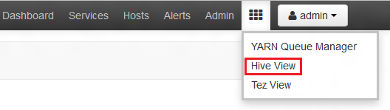
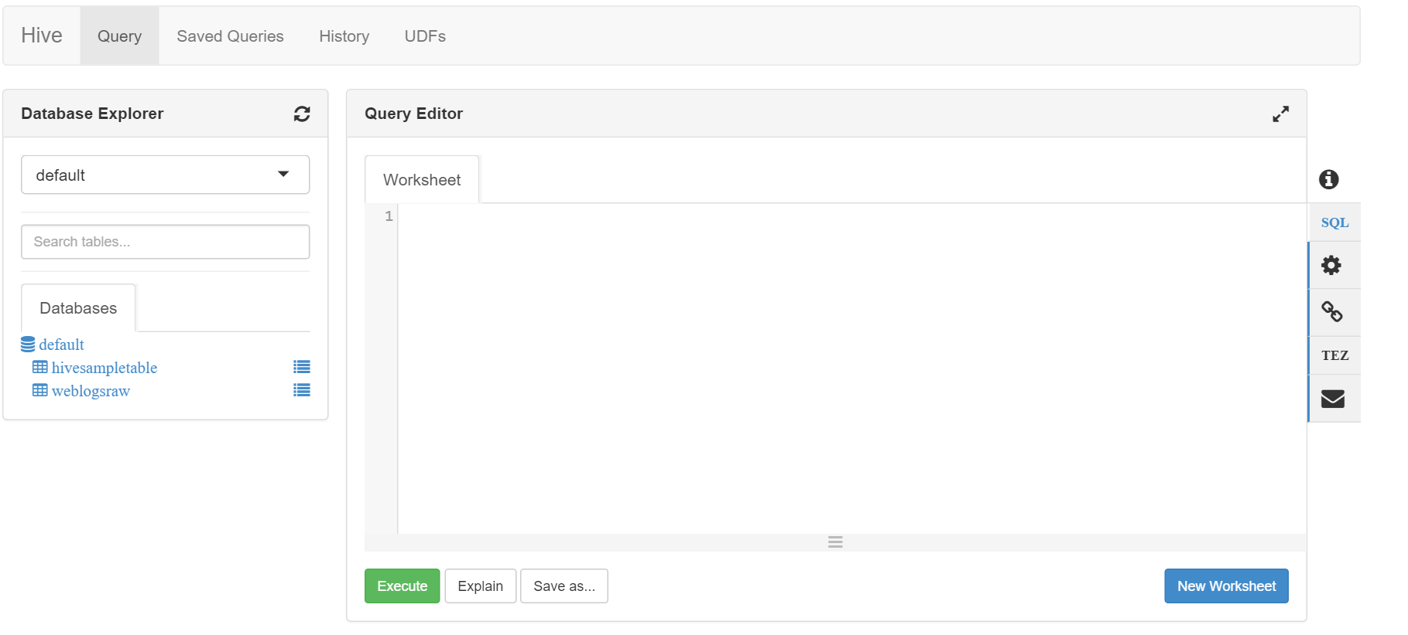
Hive Query in Ambari
Navigate to Ambari Views from Azure Portal.
Select Hive view from list of views:
Enter new table queries in the Query Editor
View tables in the database explorer
Notes:
1. More about Ambari Views: https://azure.microsoft.com/en-us/blog/using-ambari-views-to-author-hive-and-pig-queries/

Slide 13
Module 4: Querying with Power BI
Notes:
Data Sources for Power BI: https://powerbi.microsoft.com/en-us/documentation/powerbi-service-get-data/

Slide 14
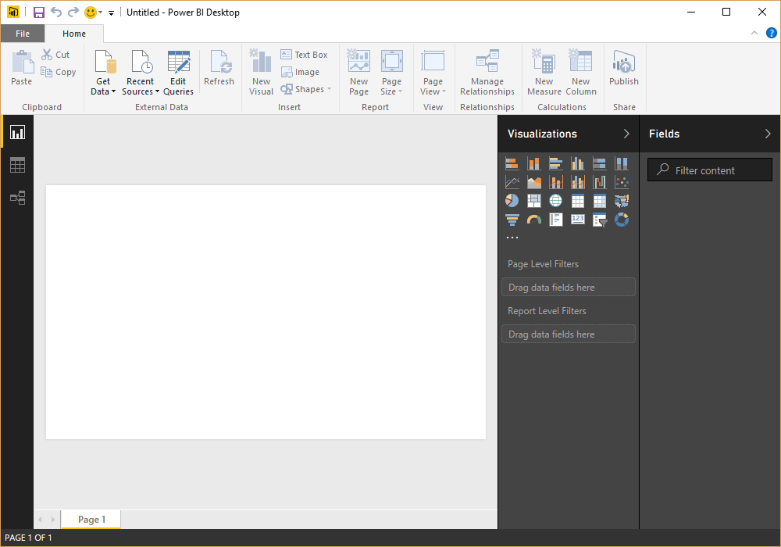
Power BI
A Reporting System for Multiple Data Sources
Available in:
Web Portal
Power BI Desktop
Microsoft Excel
Mobile apps (iOS, Android, Windows)
Author
Connect to Data
Shape the Data
Model the Data
Report on the Data
Publish
Local
To Service
Notes:
Guided Learning: https://powerbi.microsoft.com/en-us/guided-learning/
4-part online course for Power BI in Excel 2013: https://mva.microsoft.com/en-US/training-courses/data-visualizations-with-power-bi-in-excel-2013-8889?l=kBrlM2A3_104984382

Slide 15
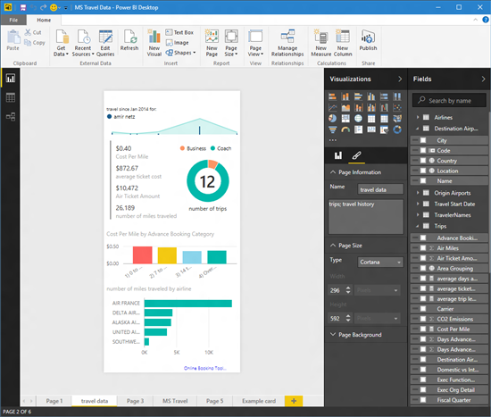
Power BI - Accessing
Microsoft Excel
Web Portal
Power BI Desktop
Mobile apps (iOS, Android, Windows)
Notes:
Web Portal – http://powerbi.com
Power BI Desktop - https://powerbi.microsoft.com/en-us/documentation/powerbi-desktop-latest-update/
Excel - https://support.office.com/en-us/article/Get-Transform-in-Excel-2016-881c63c6-37c5-4ca2-b616-59e18d75b4de?ui=en-US&rs=en-US&ad=US
Mobile Apps - https://powerbi.microsoft.com/en-us/Mobile
Use this link to see what you are able to do: https://app.powerbi.com/view?r=eyJrIjoiYWU2ZWQyNzYtOWNlZi00YmU2LWIyYjYtMjk1MWY5YjIyZGIyIiwidCI6ImY1NDViZDY2LTdjM2YtNDcyOS04NTFhLWI3Y2EzYWM5ZmI2ZSIsImMiOjh9

Slide 16

Power BI – Authoring Reports
Components:
Process:
Data
Reports
Dashboards
Connect to Data
Shape the Data
Model the Data
Report on the Data
Notes:
Getting Started: https://powerbi.microsoft.com/en-us/documentation/powerbi-desktop-getting-started/

Slide 17
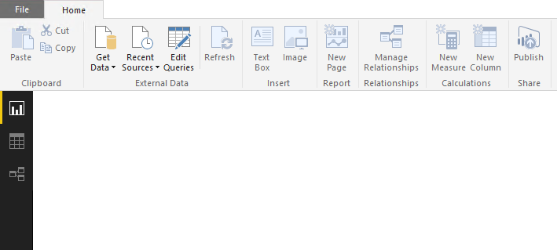
Power BI Desktop Views
Report view
Data view
Relationships view
Notes:
Data View: https://powerbi.microsoft.com/en-us/documentation/powerbi-desktop-data-view/
Relationship View: https://powerbi.microsoft.com/en-us/documentation/powerbi-desktop-relationship-view/
Report View: https://powerbi.microsoft.com/en-us/documentation/powerbi-desktop-report-view/

Slide 18




Lab:
Analyzing data in Power BI
Notes:
Option 1: First-time, comprehensive example: https://powerbi.microsoft.com/en-us/documentation/powerbi-desktop-getting-started/
Option 2: EMEA soccer data example : http://tinyurl.com/buckwoodypbi1
Option 3: US retirement example: http://tinyurl.com/buckwoodypbi2
Option 4: Open Power BI or Excel, and use this data source: http://services.odata.org/V4/Northwind/Northwind.svc/
Define Relationships
Change the data types to be appropriate for location, summation, etc.
Create linked graphics based on those relationships and data elements

Slide 19

Creating Impactful Reports
Power BI
Notes:
On Demand Webinar: http://bit.ly/29q32I1
Interesting Example of Good Visualization: http://www.datapointed.net/2010/01/crayola-crayon-color-chart/
Another one: http://community.powerbi.com/t5/Data-Stories-Gallery/Vizion-Solutions-MLB-Analysis/m-p/60504
Great book on data visualization: The Wall Street Journal Guide to Information Graphics: The Dos and Don'ts of Presenting Data, Facts, and Figures Paperback – December 16, 2013
Article on Data Storytelling: http://www.forbes.com/sites/brentdykes/2016/03/31/data-storytelling-the-essential-data-science-skill-everyone-needs/#47248463f0c8

Slide 20
Creating a Useful Report
Power BI
Find and Verify your Source Data
Locate the most authoritative data
Get permission where required
Shape and Model the Data
Find the main message
Remove extraneous data
Change the types to be more effective in interactive layouts
Select the right Graphic
Scale, increments, axes
Simple is better
Tell a story
Notes:
From the book The Wall Street Journal Guide to Information Graphics: http://www.amazon.com/Street-Journal-Guide-Information-Graphics/dp/0393347281
Finding the right visualization: http://blogs.msdn.com/b/microsoft_business_intelligence1/archive/2012/10/08/best-practices-in-data-visualization.aspx

Slide 21
Creating Useful Dashboards
Power BI
Consider the audience
Make sure you account for culture
Single Screens where possible
Use all your whitespace
Fonts and readability
Make the most important data the biggest
Top right is the most valuable space
Use cards with linked charts
Show information once
No data overlap
Notes:
Full article: https://powerbi.microsoft.com/en-us/documentation/powerbi-service-tips-for-designing-a-great-dashboard/

Slide 22
Interaction and Integration
Power BI
Linking Charts
Find out what the audience needs to see
Add Slicers where needed
Allows for one visualization to be many
Integrate with Cortana
Link your accounts
Notes:
Power BI Q and A: https://powerbi.microsoft.com/en-us/documentation/powerbi-service-q-and-a/
R Visualizations: http://community.powerbi.com/t5/R-Script-Showcase/bd-p/RVisuals?utm_content=buffer78b5e&utm_medium=social&utm_source=facebook.com&utm_campaign=buffer

Slide 23
Understand how to publish an Azure ML API
Understand the access methods of Azure Storage and Intelligent processing systems
Understand the options to send a HIVE query to an HDI system
Use Power BI to Access Data
Notes:
Questions?

